Slide 1
Design the best Playground ever!
We need your help to design a fun and exciting place for children and young people to play.

Slide 2
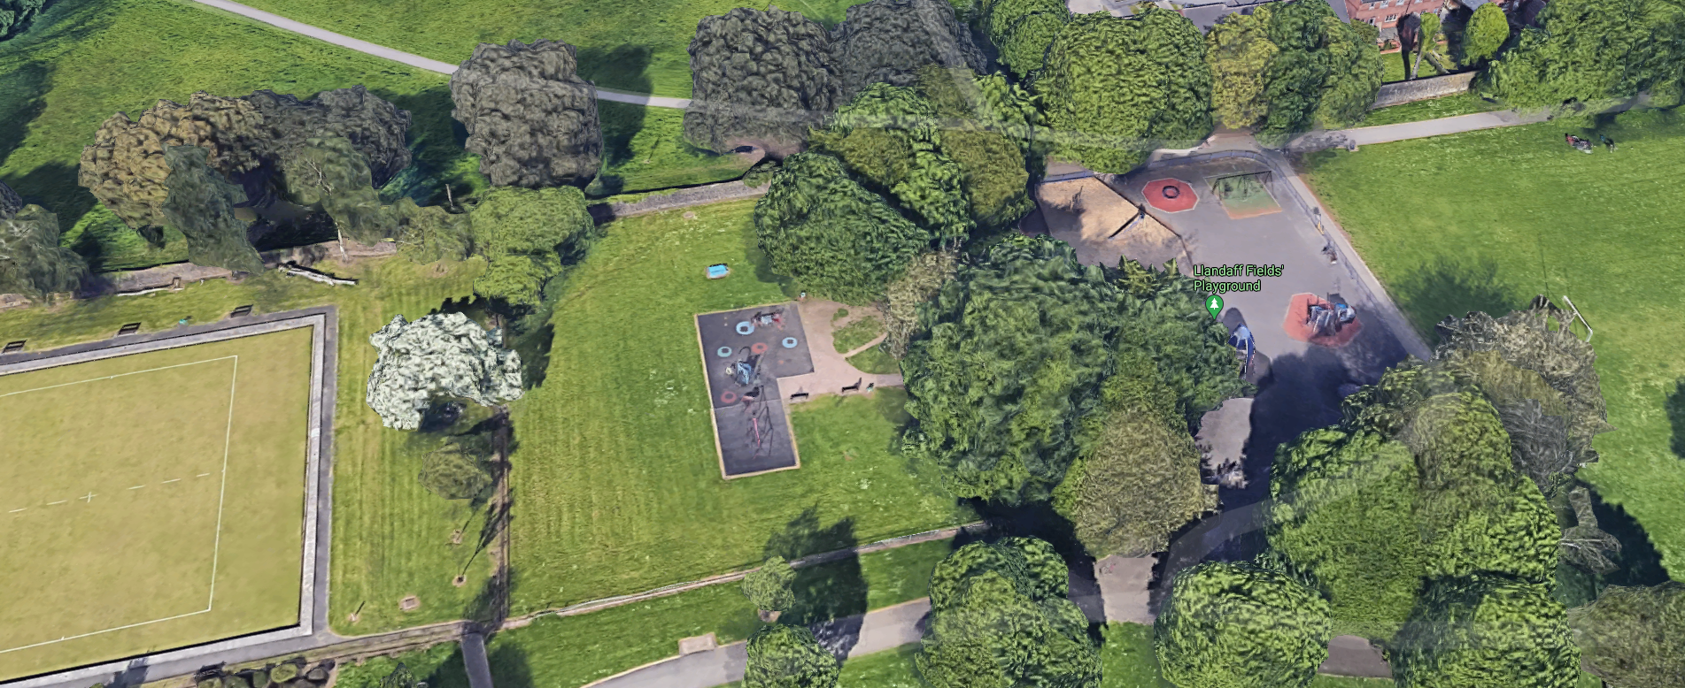
Llandaff Fields
Llandaff fields playground has been chosen to be redeveloped into an amazing play area with lots of exciting activities.
It's located in the centre of Cardiff and the designers want to make it SO special that people from all over the city to travel there to play.
Take a look at the map, do you know where it is? Have you been there before?
The playground will have activities accessible to all and a bicycle parking.

Slide 3
5 Types of Play
The designers have chosen to break the activities into 5 types of play and need your help choosing the most popular equipment.
Embankments and Slides
Woodland & Natural Play
Adventure & Active Zone
Puzzles, Education and Music
Toddler Area
Notes:
When you read out each of the 5 types of play, it might be worth asking the class what they think each one might look like – embankments and slides might be a bit self-explanatory so feel free to skip.
EMBANKMENT & SLIDES (Encourage agility, climbing, ‘Reward’, & slide play)
WOODLAND/NATURAL PLAY (Back to Nature)
ADVENTURE/ACTIVE ZONE (Imaginative play, Exercise & equipped play)
PUZZLES, EDUCATION & MUSIC (Area to encourage problem solving and learning)
TODDLER AREA (play zone for 2-5 year olds)

Slide 4
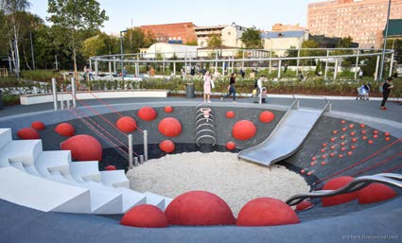
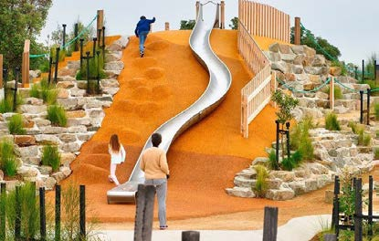
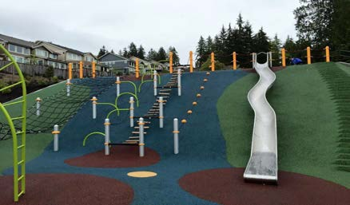
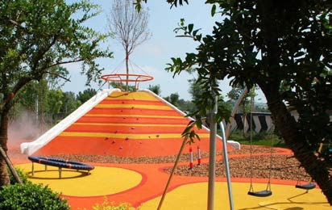
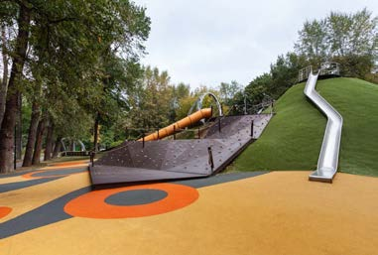
Embankments and Slides
A
B
C
D
E
Notes:
-Ask your class to look at the images and decide which two images look most exciting.
-Get them to write the corresponding letters on their worksheets. -Briefly, review one or two answers with group. Why did they make their choice?
How would they interact with the space?
What could be better? Etc.

Slide 5
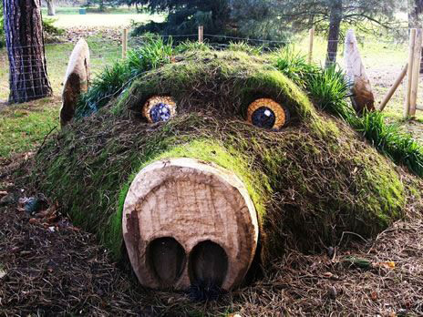
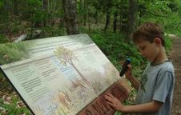
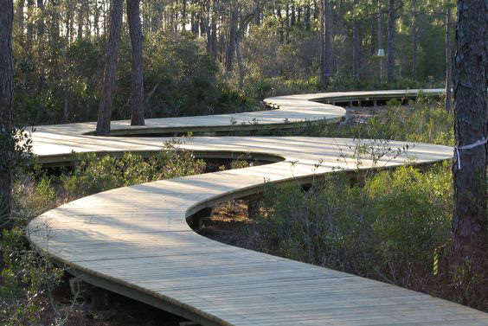
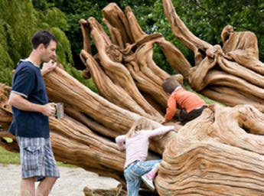
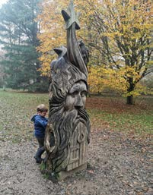
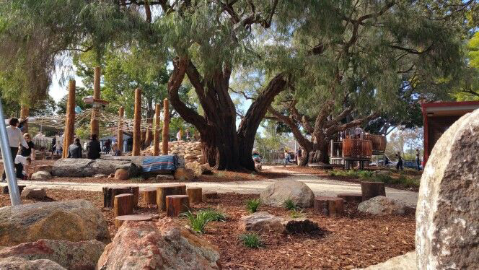
Woodland & Natural Play
A
B
C
D
E
F
Notes:
-Ask your class to look at the images and decide which two images look most exciting.
-Get them to write the corresponding letters on their worksheets. -Briefly, review one or two answers with group. Why did they make their choice?
How would they interact with the space?
What could be better? Etc.

Slide 6
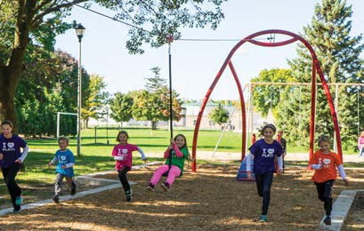
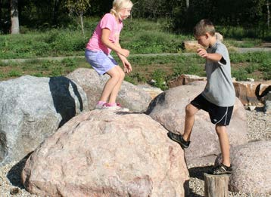
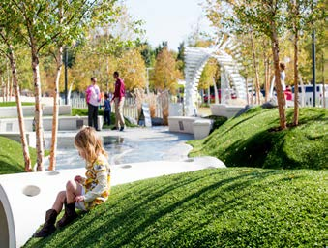
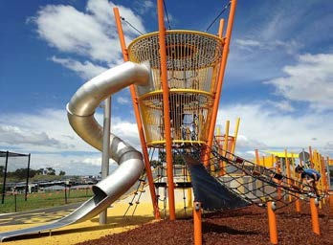
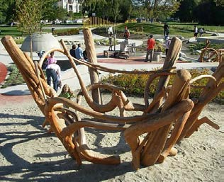
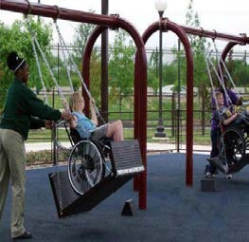
Adventure & Active Zone
A
B
C
D
E
F
Notes:
-Ask your class to look at the images and decide which two images look most exciting.
-Get them to write the corresponding letters on their worksheets. -Briefly, review one or two answers with group. Why did they make their choice?
How would they interact with the space?
What could be better? Etc.

Slide 7
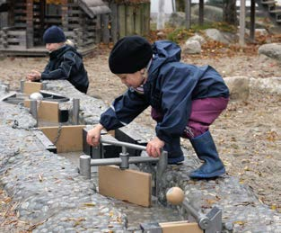
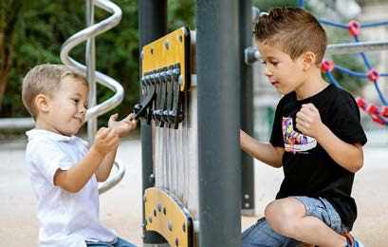
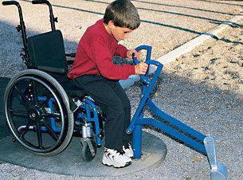
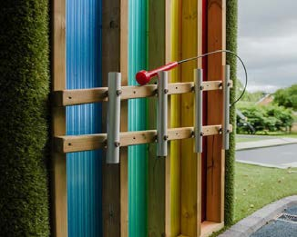
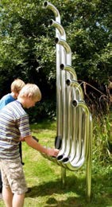
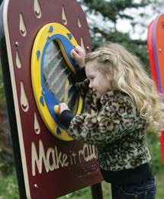
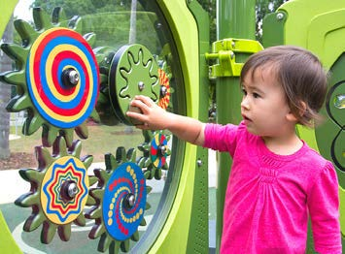
Puzzles, Education and Music
A
B
C
D
E
F
G
E
Notes:
-Ask your class to look at the images and decide which two images look most exciting.
-Get them to write the corresponding letters on their worksheets. -Briefly, review one or two answers with group. Why did they make their choice?
How would they interact with the space?
What could be better? Etc.

Slide 8
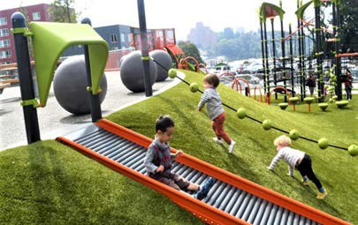
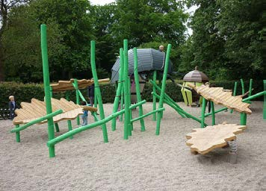
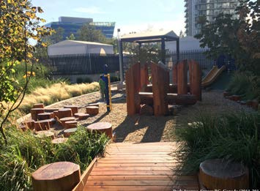
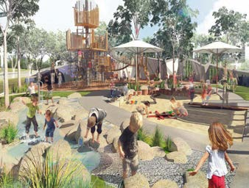
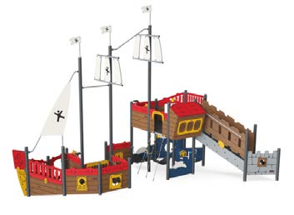
Toddler's Area
A
B
C
D
E
Notes:
-Ask your class to look at the images and decide which two images look most exciting.
-Get them to write the corresponding letters on their worksheets. -Briefly, review one or two answers with group. Why did they make their choice?
How would they interact with the space?
What could be better? Etc.

Slide 9
What's the best park you've ever been to?
Notes:
-This task can be done in different ways
-split a class into groups and ask them to share their experiences with each other.
-ask pupils to close their eyes and think about the best playground/park/play area/playcentre they have ever been to. What did they enjoy most about it? What could have been better?
Why did they enjoy it?

Slide 10
Drawing Activity
Get your pens and pencils and draw the park of your dreams!

